Slide 1

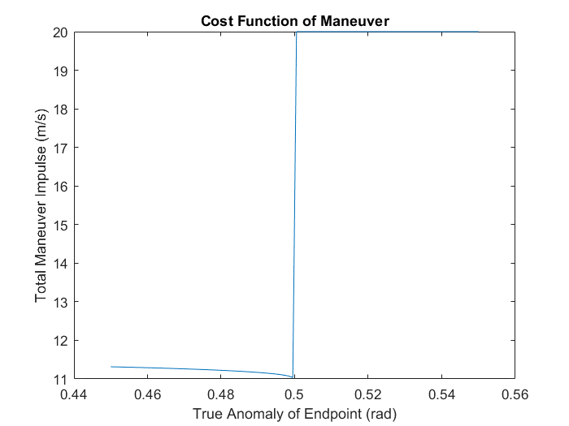
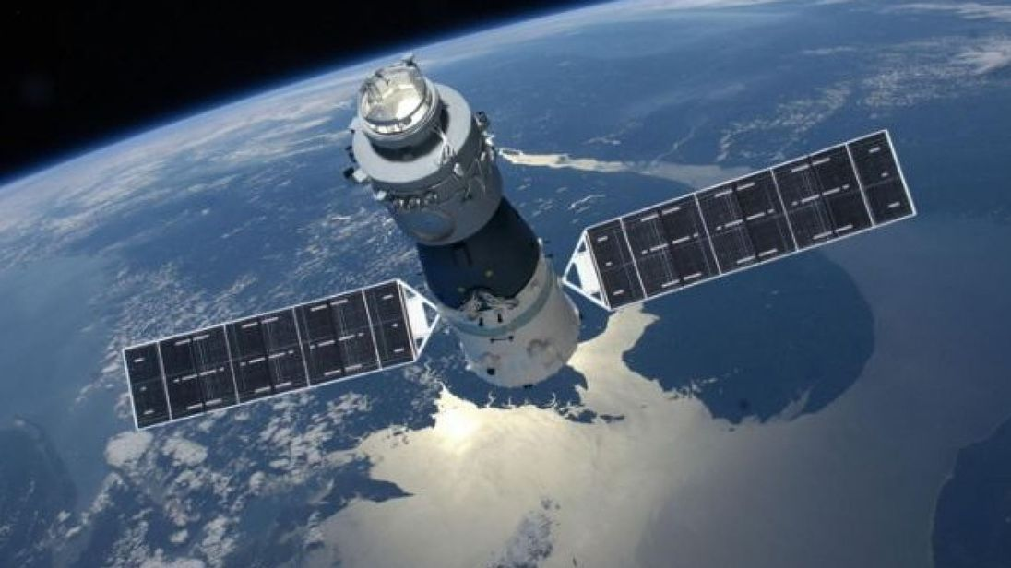
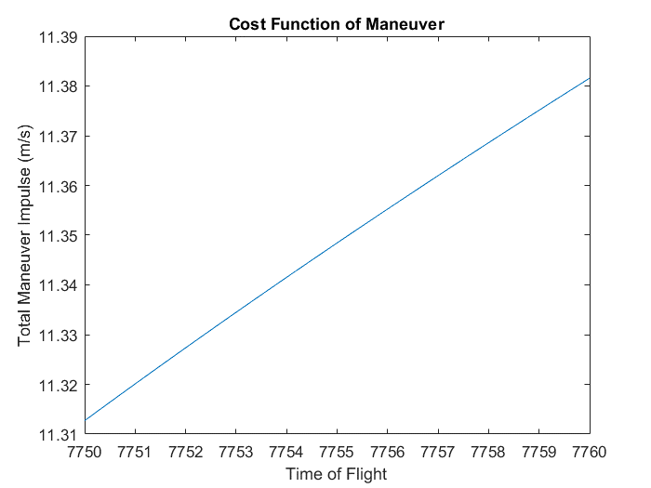
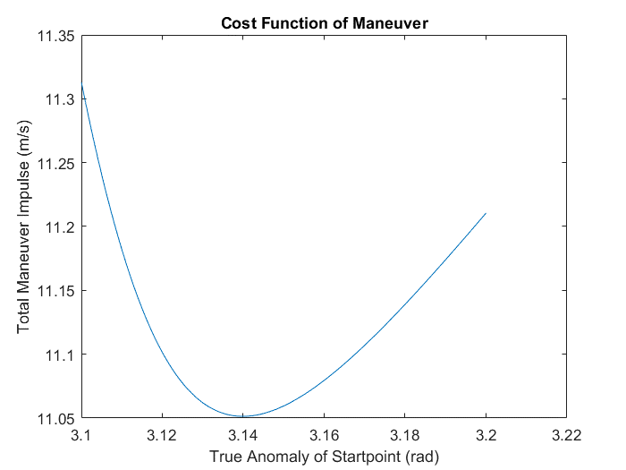



Recovery of the Tiangong 1 Spacecraft
Jacob Bailey
Gus Lee
Michael Lesnewski
INTRODUCTION
Maneuver Methodology
Results
Plots Continued
Background
The Chinese space station Tiangong 1 re-entered the Earth’s atmosphere and fell to its demise on April 2, 2018 over the South Pacific Ocean.
Project Objective:
Based on set of initial conditions ($R_{0},V_{0}),$ the space station’s orbit is to be propagated at least 30 days into the future. At which time an optimal maneuver is to be initiated in order to be the station back to initial orbit and saving it from its demise.
The decayed and desired orbits were propagated for orbit each.
The true anomaly of the starting and end points were varied over the range of 0 to 2π.
The time of flight (TOF) between the points was varied over roughly 0 to 3 orbital periods (1.5 to 4.5 hours).
At each point in space, a set of initial and final position vectors are generated.
These vectors along with the time of flight are fed into a Lambert Solver (via Izzo and Lancaster, Blanchard & Gooding) to find the corresponding velocities to the arc between them.
The resulting velocities were subtracted from the orbital velocity at the corresponding point in the orbit:
${dV}_{1}= V_{1,Lambert}−V_{Decayed}$
${dV}_{2}= V_{2,Lambert}−V_{Desired}$
These impulsive delta velocities were stored, and the combination of their magnitudes were used as a cost function.
After searching over the entire design space, the search mesh was refined iteratively to enclose a smaller region of design space, until a suitable convergence was reached.
Minimum Burn Cost: 11.3130 km/s
Position for Burn One: 6263.6924 -2214.1144 -462.3803 km, ECI
Delta Velocity, Burn One: 10.6062 km/s
Position for Burn Two: -4969.7293 3798.6345 2232.9881 km, ECI
Delta Velocity, Burn Two: 0.7068 km/s
Time of Flight: 7750.0334 seconds
True Anomaly of First Burn: 3.1010 rad
True Anomaly of Second Burn: 0.4520 rad
Burn 1: 0.02281 -0.01937 10.60612 km/s, ECI
Burn 2: -0.54520 0.43561 0.11204 km/s, ECI
Plots
Initial Conditions
The following plots show at which true anomaly of the starting point, ending point and time of flight the impulsive maneuver is at a minimum.
Keplerian Elements at epoch:
$\left[\begin{matrix}\begin{matrix}a \\ e \\ i\end{matrix} \\ \begin{matrix}Ω \\ ω \\ f\end{matrix}\end{matrix}\right]=\left[\begin{matrix}\begin{matrix}6657.391 \\ .002594 \\ 42.7480\end{matrix} \\ \begin{matrix}345.3258 \\ 124.4125 \\ 287.3948\end{matrix}\end{matrix}\right]$
Keplerian Elements after 30 days of decay:
$\left[\begin{matrix}\begin{matrix}a \\ e \\ i\end{matrix} \\ \begin{matrix}Ω \\ ω \\ f\end{matrix}\end{matrix}\right]=\left[\begin{matrix}\begin{matrix}6645.829 \\ .002069 \\ 42.732\end{matrix} \\ \begin{matrix}156.2116 \\ 8.1985 \\ 80.7678\end{matrix}\end{matrix}\right]$
Software: How-to
Inputs:
Tiangong 1’s initial position and velocity vectors at epoch
Additional inputs???
Outputs:
Total cost of the maneuvers (total ΔV)
Additional outputs???
Describe how to use our code…..
Conclusions
The recovery maneuver had a burn cost of 11.313 km/s and required two different burn events.

